Slide 1

Distribution of Classes at Texas State University
Rowan Rollman & Joseph Valadez

Slide 2
General Introduction
We compiled a list of all the courses offered at Texas State University, including courses offered at the Round Rock campus
Our goal is to do a general analysis of the courses at Texas State and somewhat determine which department has the biggest share of university resources.
Notes:
Easiest to read from slide

Slide 3
Questions
Within each department, what is the average number of lab hours?
Which department offers the most classes?
Which department has the highest average?
What percentage of all classes does that number make up?
Which department has the greatest number of upper level (5000-7000) level courses?
Which department has the greatest number of Credit/No Credit classes?

Slide 4
Data Collection
Source: Course Catalog from Texas State http://mycatalog.txstate.edu/courses/
URL Examples:
http://mycatalog.txstate.edu/courses/acc/
http://mycatalog.txstate.edu/courses/eco/
http://mycatalog.txstate.edu/courses/math/
Notes:
Doing this required us to loop through each department page and scrape the information from each class.
I want to loop through a bunch of the pages on this website, so the URL changes slightly every time.
To avoid having our IP address flagged for sending too many page requests a sleep function was added which delays page requests by random intervals.

Slide 5
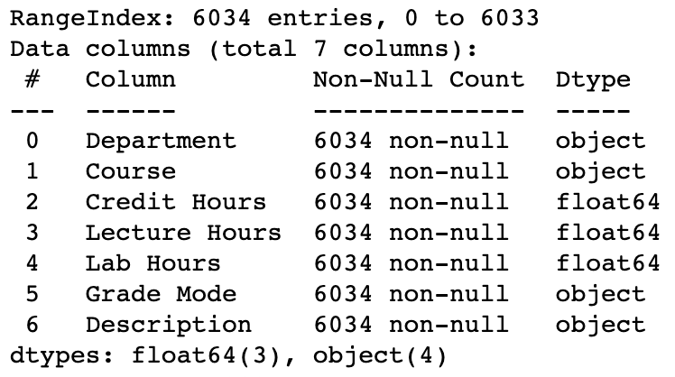
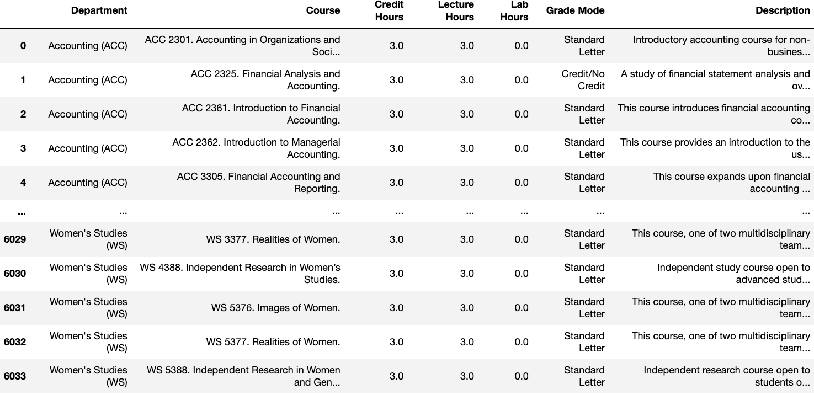
Data Cleaning
Cleaned data by slicing text blocks from the web pages and sorting them into their respective columns

Slide 6

Data Analysis

Slide 7
Which department offers the most classes?
Biology (BIO) has 267 classes
What percentage of all classes does that number make up?
These account for 4.424925% of classes at Texas State
Notes:
The second part to that question was “What percentage does that make up within the whole university?”. We also wanted to visualize other statistics of classes per department (refer to chart)

Slide 9
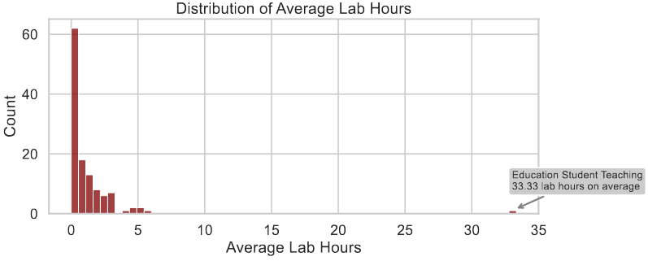
Department | Lab Hours
Education Student Teaching (EDST) | 33.333333333333300
Music Ensemble (MUSE) | 5.903225806451610
Athletic Training (AT) | 5.171875
Nature and Heritage Tourism (NHT) | 5.0
Clinical Laboratory Science (CLS) | 4.904761904761910
Physical Therapy (PT) | 4.829268292682930
Radiation Therapy (RTT) | 4.37037037037037
Engineering (ENGR) | 3.1470588235294100
Art Foundation (ARTF) | 3.0
International Studies (IS) | 3.0
Which department has the highest average number of lab hours?
Education Student Teaching has an average of 33.33 lab hours
Within each department, what is the average number of lab hours?

Slide 10
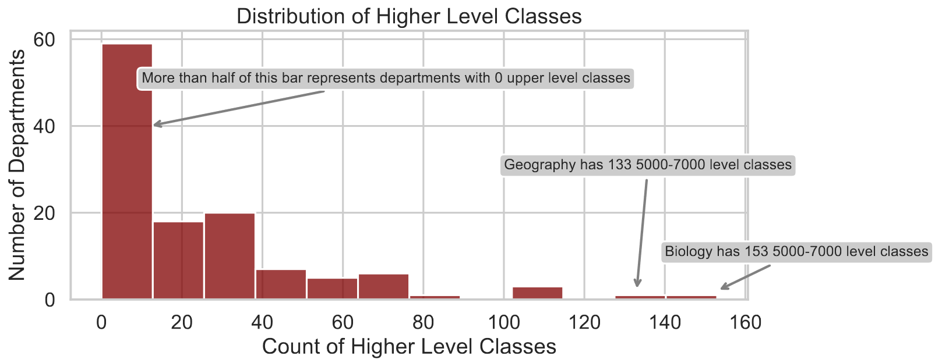
Which department has the greatest number of upper level (5000-7000) level courses?
What the course strings looked like:
ACC 2325. Financial Analysis and Accounting.
Notes:
*There are 35 departments that have 0 upper level classes*
*Biology had 267 classes total, 153 upper, so 57% of their classes are upper level
Talk about the data slicing that had to happen:
Split each "course" into the 3 parts:
Abbreviation (CS)
Course number (1428)
The excess (course title, so "Foundations of Computer Science 1")
Keeping track of what department the program is in, count how many of the courses start with 5-7

Slide 11
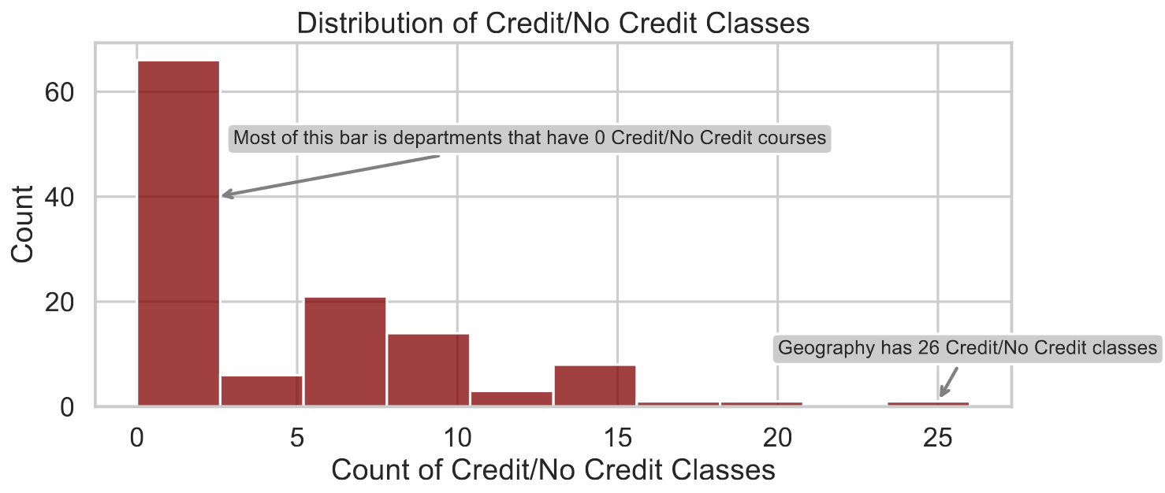
Which department has the greatest number of Credit/No Credit classes?
Notes:
*There are 52 departments that have no Credit/No Credit courses.*
During this section, we also learned that there are more grade modes than Standard Letter and Credit/No Credit
Leveling/Assistantships and Developmental
We didn’t expect geography to be such a stone cold field <- one of us needs to make this joke.

Slide 12
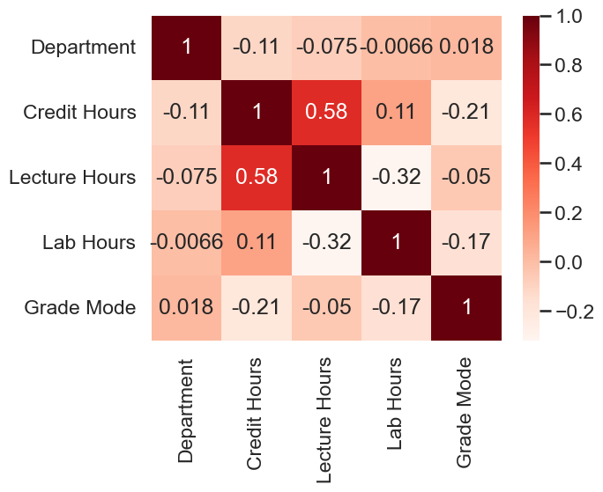
Using Heatmap To Look for Correlation
Notes:
Wanted to see if there was any correlation between any of our columns, and the only thing was Credit Hours and Lecture Hours were somewhat correlated, but everything else was either not coorelated or had a negative correlation.

Slide 13
Interpretation of data
From the data we've gathered we have assessed the following
Biology has the most advanced level classes
Geography has the highest average number of pass/fail classes
Education has the most lab/practical hours on average
Biology makes up the highest percentage of classes offered at Texas state university.

Slide 14

Questions

